Slide 1
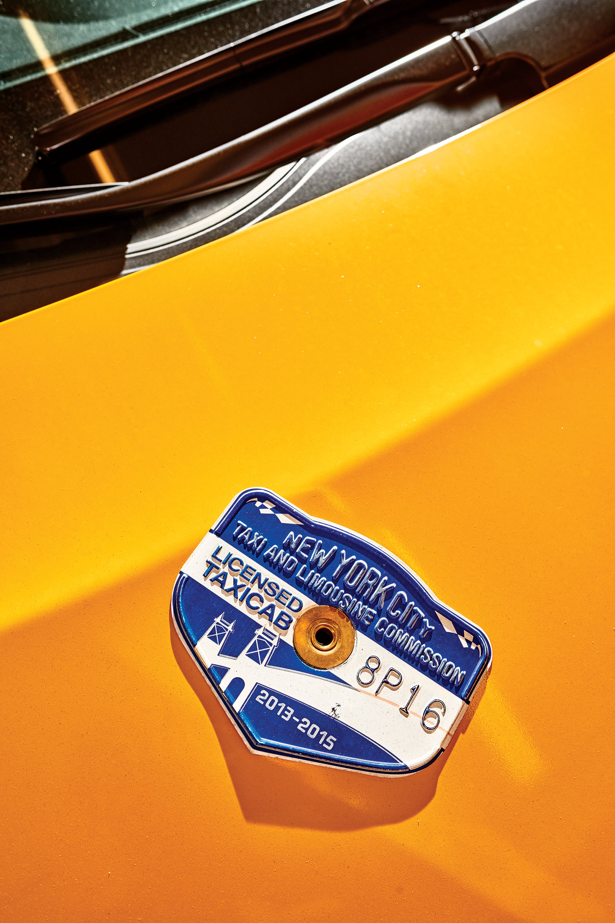
NYC Taxi Data Abhishek Das

Slide 2
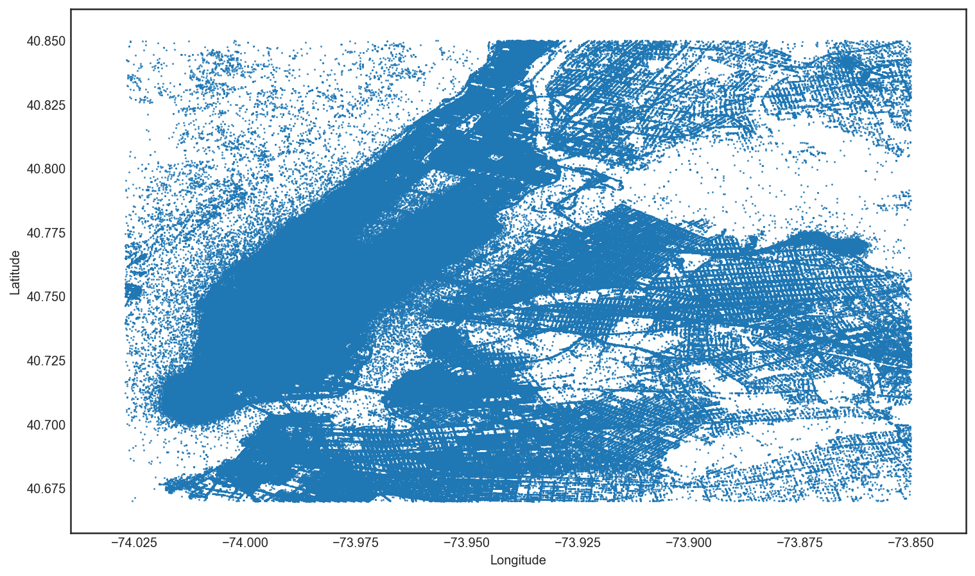
One Month
2 companies
13,276 taxis
34 million miles
$184 million in revenue

Slide 3
Passengers

Slide 4
Non-Airport Fares < $35 Median Airport fares $52

Slide 5
Airport tips are higher

Slide 6
Airport Total Amounts Higher

Slide 7
Mon, Tue & weekend evenings are busiest

Slide 8
12.36m trips in Manhattan
Notes:
Most populous of New York’s five boroughs

Slide 9
Airport travel times fluctuate most

Slide 10
Shorter fares reliable

Slide 11
Minimum Sample Size
Margin of Error = 5%
Confidence Interval = 95% -> Z-Score = 1.96
Standard Deviation = 50%
Sample Size = (1.96*0.5/0.05)^2 = 385 trips

Slide 12
Features
Average Speed per hour
Trips per hour
Pickup Latitude/Longitude
Drop off Latitude/Longitude
Trip Distance
Pickup Hour
Day of Month
Taxi Shift

Slide 13
Predicting Taxi Fares

Slide 14
Predicting % Tip

Slide 15
Maximize Daily Earnings

Slide 16
Profitable Evening Routes

Slide 17
Non-Crowded Trips

